Slide 1
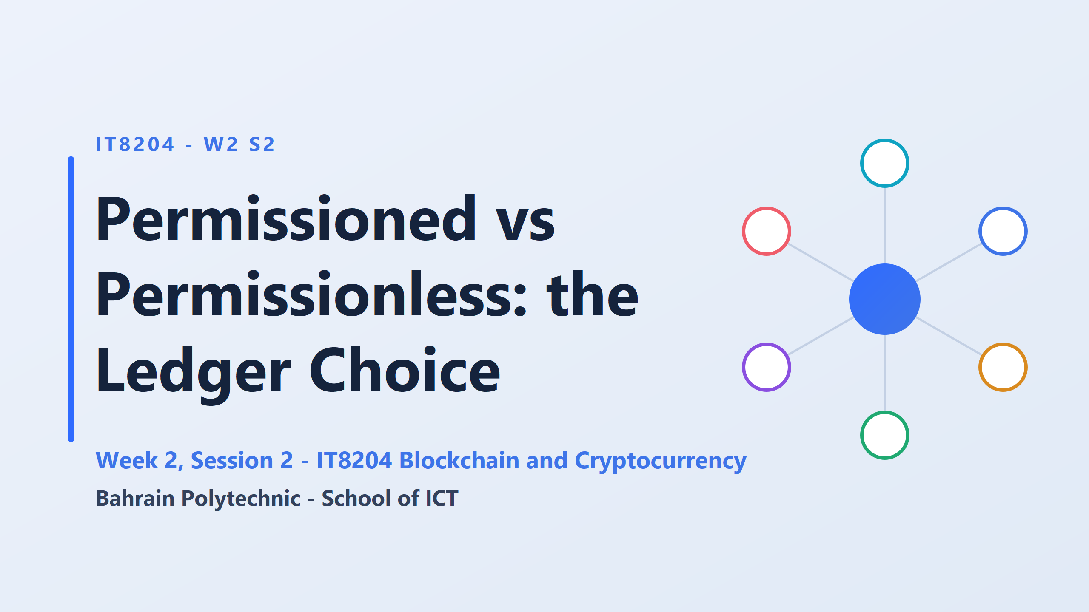

Slide 2
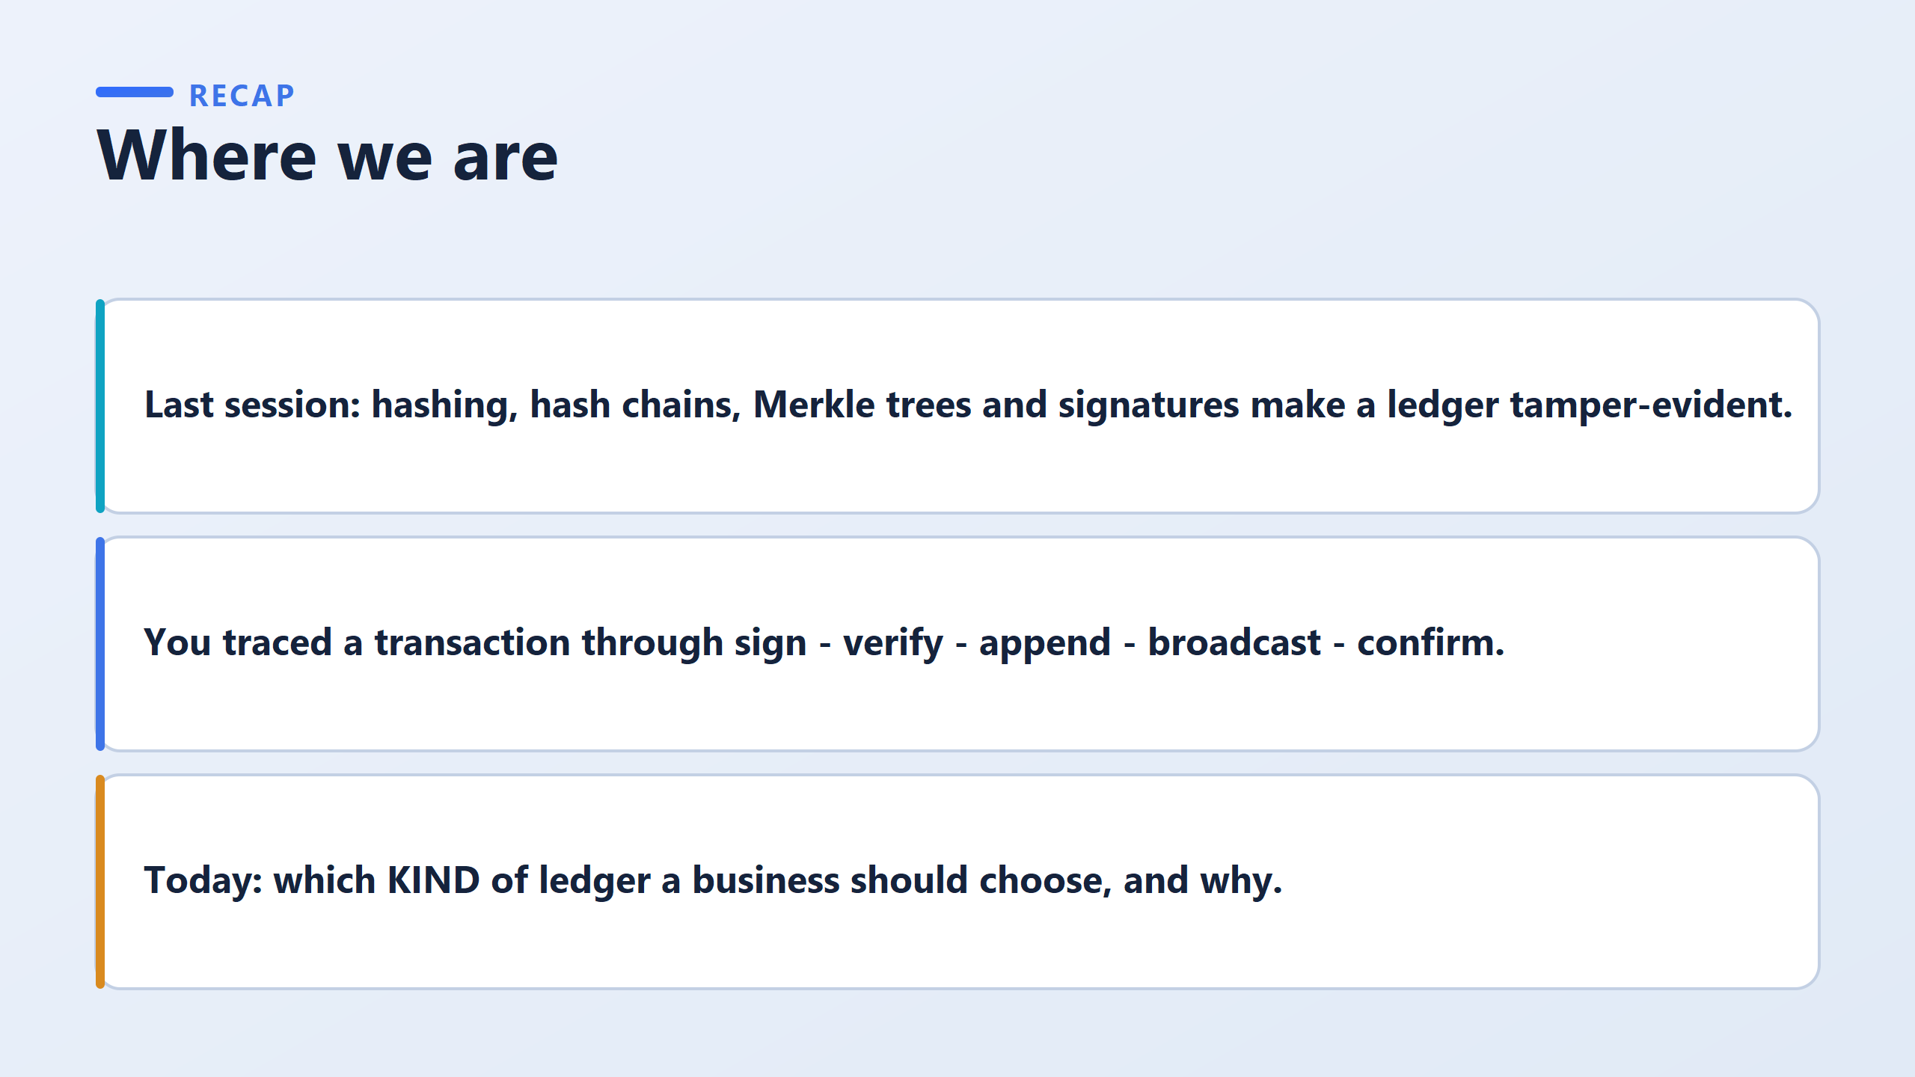
Last time was about keeping records honest.
Today is about who's allowed to write them.
Those are two separate questions — you can have a tamper-evident ledger whether it's open to the whole world or locked to eight banks?
why it's a business question, not a tech one
Whether a ledger is open or closed isn't a technical setting — it's a decision with real consequences for speed, privacy, control, and licensing.

Slide 3
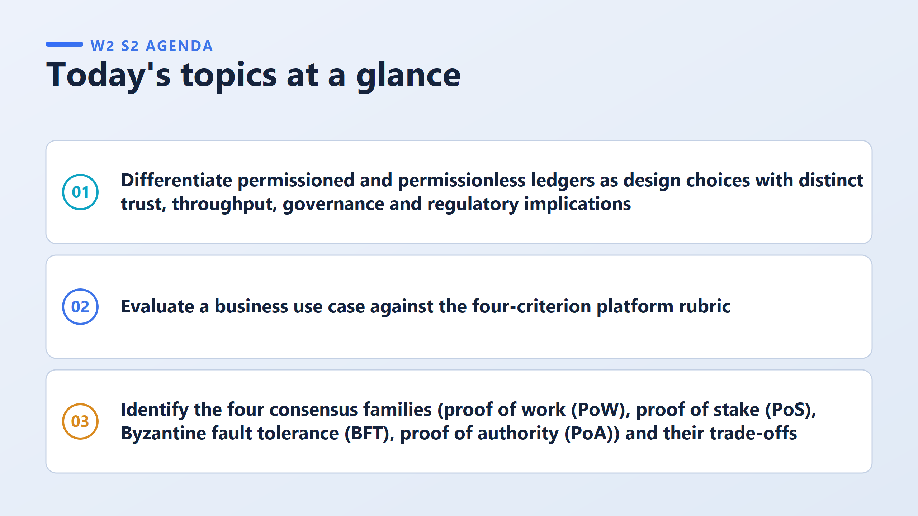
Hint: Evaluating a use case means picking ONE of the four criteria that actually decides the answer, and explaining why the other three don't matter as much here
Hint: You don't need the math behind PoW, PoS, BFT, or PoA. You just need to know which one fits which situation, and why." Four labels, four trade-offs — that's it.

Slide 4
What "permissioned" means: only approved people can join and write to the ledger (like 8 specific banks).
"Permissionless" means anyone in the world can join (like Bitcoin or Ethereum).
The wrong idea students often have: they assume "open to everyone" = better/stronger, and "restricted to a few banks" = weaker or somehow "fake" blockchain. Like ranking them 1st place vs 2nd place.
Why that's wrong: it's not a ranking, it's a choice.
Each one is just built for a different job: Open (permissionless) → nobody controls it, but slower, less private
Restricted (permissioned) → faster, more private, but a few parties are in charge
Neither is "more secure" — they're just secure in different ways, for different needs.
"Permissioned doesn't mean less secure, and it doesn't mean it's not a real blockchain." Just say that sentence plainly, once, clearly.
if a student later writes in their assignment “permissioned blockchains are less secure,” that’s a mistake

Slide 5
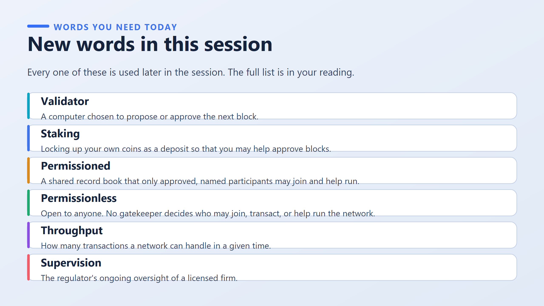

Slide 6
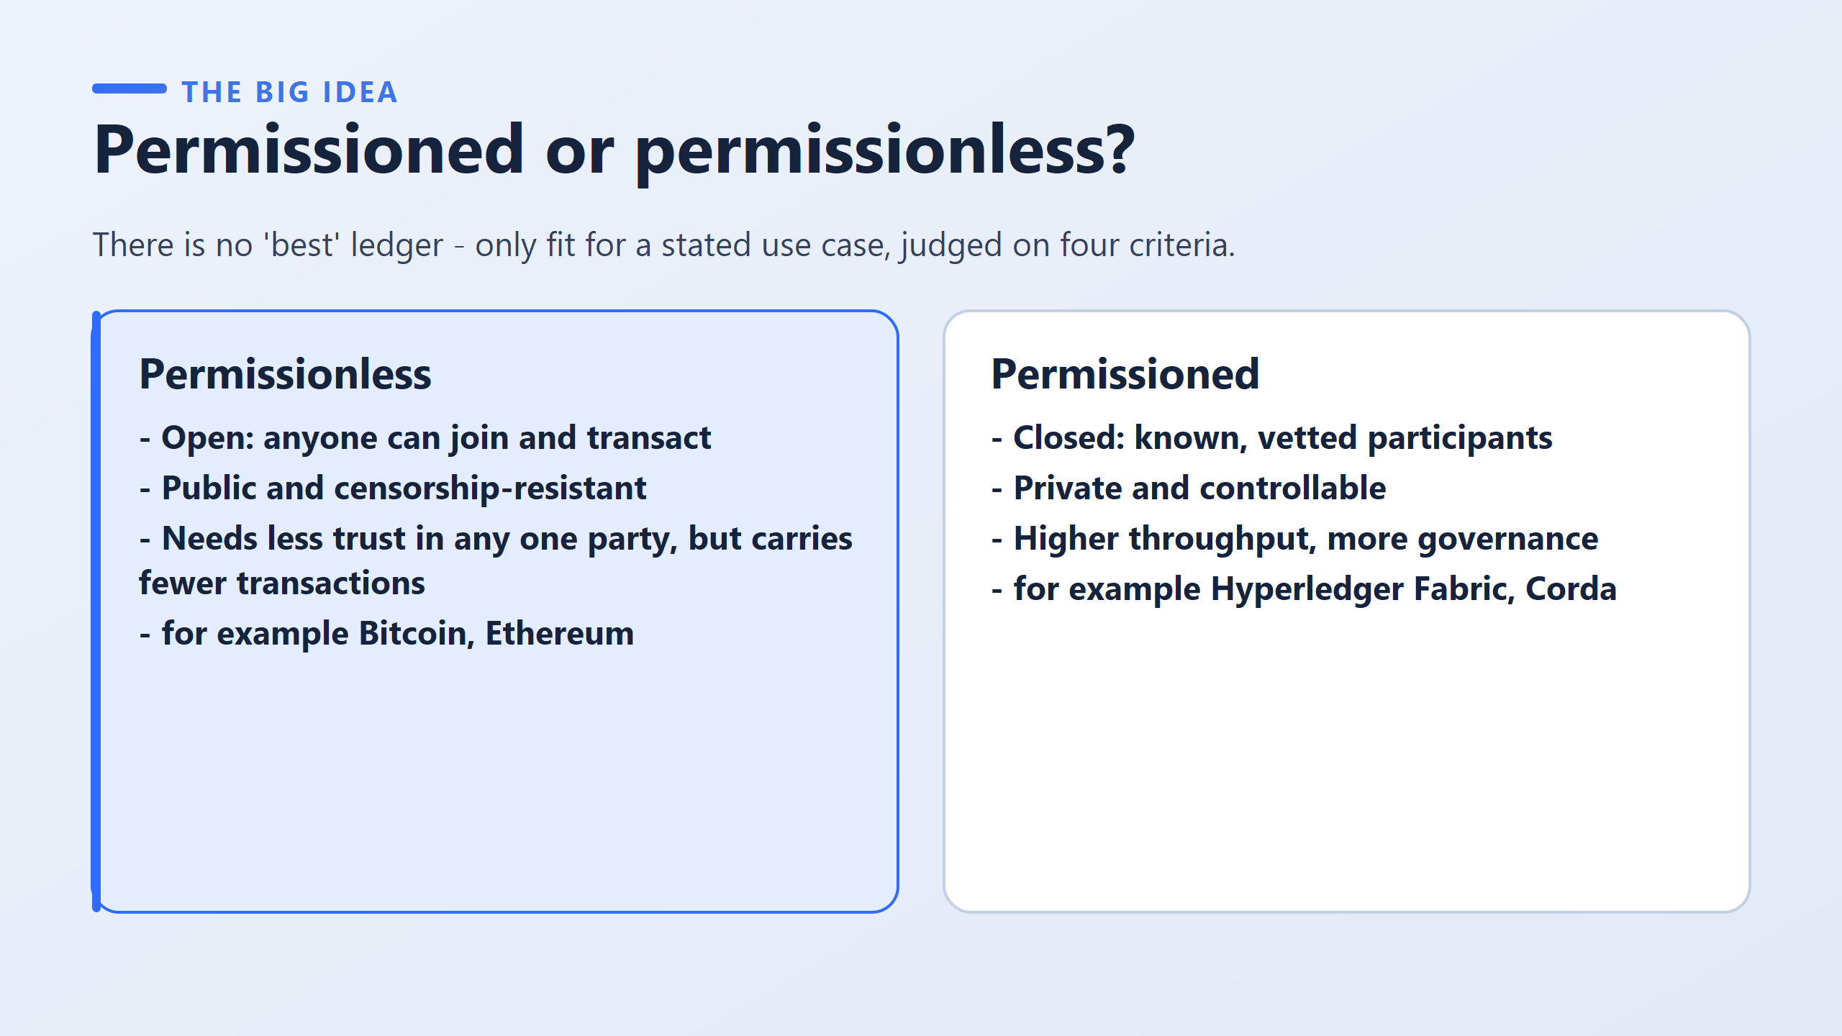
A permissioned ledger is a closed or restricted distributed database where only verified and authorized participants can access data, view transactions, or validate new blocks

Slide 7
Permissionless
"Open: anyone can join and transact" → Anyone, anywhere, can join.
"Public and censorship-resistant" → Everyone can see everything.
"Needs less trust in any one party, but carries fewer transactions" → You don't have to trust one company or boss. But it’s slower — it can’t handle as many transactions at once.
"Bitcoin, Ethereum" → the two most famous real examples.
Permissioned
Closed: known, vetted participants" → Only people who are checked and approved can join. Not open to the public.
"Private and controllable" → Outsiders can't see the data.
"Higher throughput, more governance" → It can handle more transactions at once
“Hyperledger Fabric, Corda" → two real systems banks actually use.

Slide 8
Think about the normal system
Suppose Ali has an account at Bank A and sends $1,000 to Ahmed at Bank B.
A traditional system can do:
Bank A:"Ali's account −$1,000“ Bank B:"Ahmed's account +$1,000“
The banks communicate through existing payment infrastructure.
So why introduce a permissioned ledger?
The problem appears when MANY organizations need one shared record
Imagine a trade-finance transaction involving:
Manufacturer + Exporter + Bank A + Bank B + Shipping company + Customs + Insurer
Bank A → Database A
Bank B → Database B
Shipping → Database C
Customs → Database D
Insurer → Database E
PERMISSIONED LEDGER
    Shipment created
    Shipment dispatched
    Customs approved
    Bank payment released
    Goods received
↑ ↑ ↑ ↑
Bank Customs Shipping Insurer

Slide 9
Permissionless: Anyone can potentially join and participate in the network.
Permissioned: Only authorized participants can join and perform specified roles.
Permissioned blockchain ≠ traditional database.
The important difference is that a permissioned blockchain can provide a shared ledger among multiple authorized parties, with agreed rules for validating and recording transactions.

Slide 10
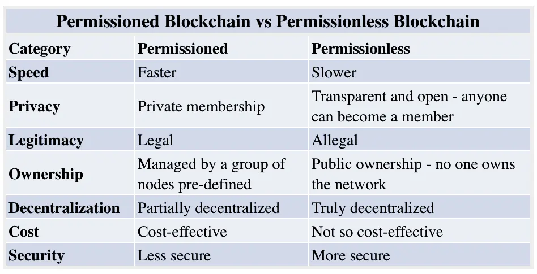

Slide 11
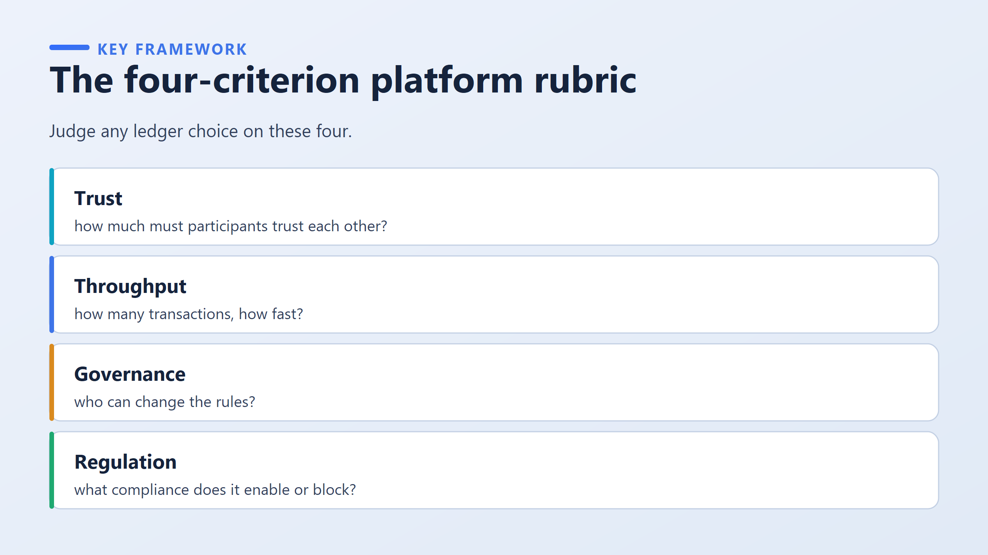
Hint: Judge any ledger choice on these four.
Trust — how much do participants have to trust each other?
Throughput — how many transactions can it handle?
Governance — who decides the rules and who can change them?
Regulation — how does a regulator supervise it?

Slide 12
A worked mini-case for practice.
A Bahraini charity wants public proof that it spent donations as promised.
Trust: donors trust nobody in particular.
Throughput: tiny.
Governance: the charity is content to be accountable.
Regulation: transparency is the goal here, not a barrier.
Trust decides it, and it points to the open option, which is the opposite conclusion from the bank case, produced by the same rubric.

Slide 13
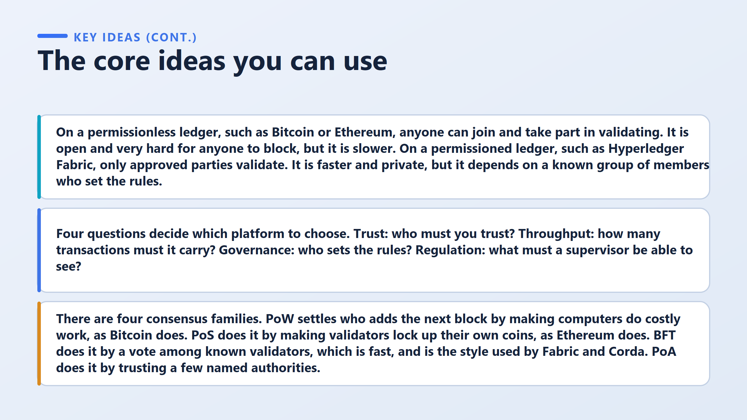
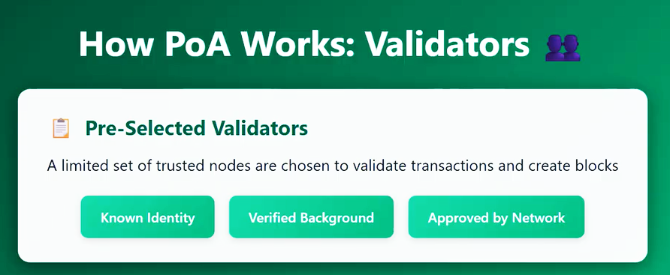
Proof of Work (PoW) — Bitcoin.
You earn the right by doing expensive computation that burns real energy.
The cost is the whole point — that’s what makes attacking it expensive.
Proof of Stake (PoS) — Ethereum.
You earn the right by locking up your own money.
Misbehave, and you lose it.
Far less energy.
Byzantine Fault Tolerant (BFT)
A known group of validators votes, and it works as long as most of them behave.
Fast — because everyone voting is already known in advance.
This is the style Fabric and Corda use.
Proof of Authority (PoA) — a small set of named, trusted authorities decide. Fastest and simplest, but the most dependent on those specific people staying honest.

Slide 14
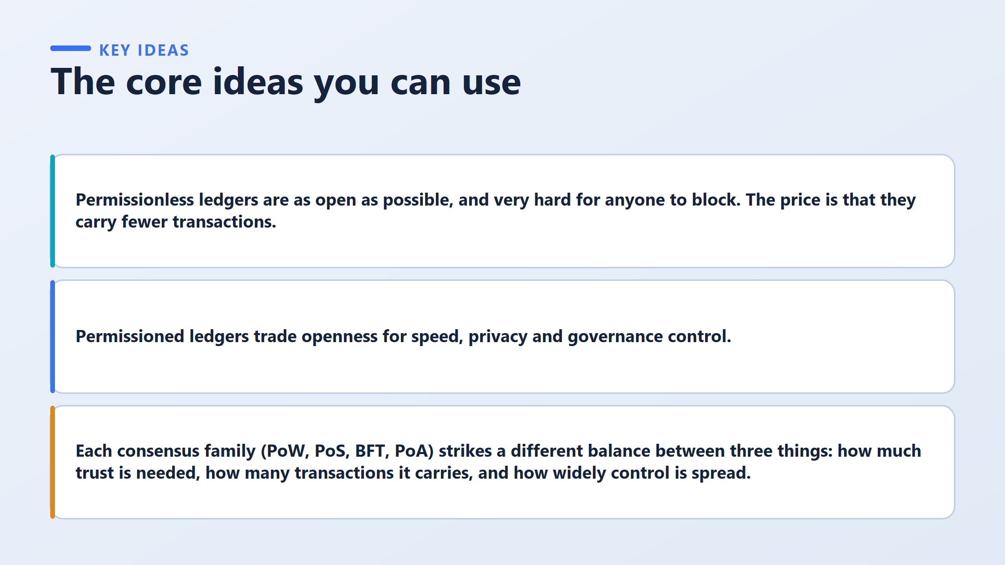

Slide 15
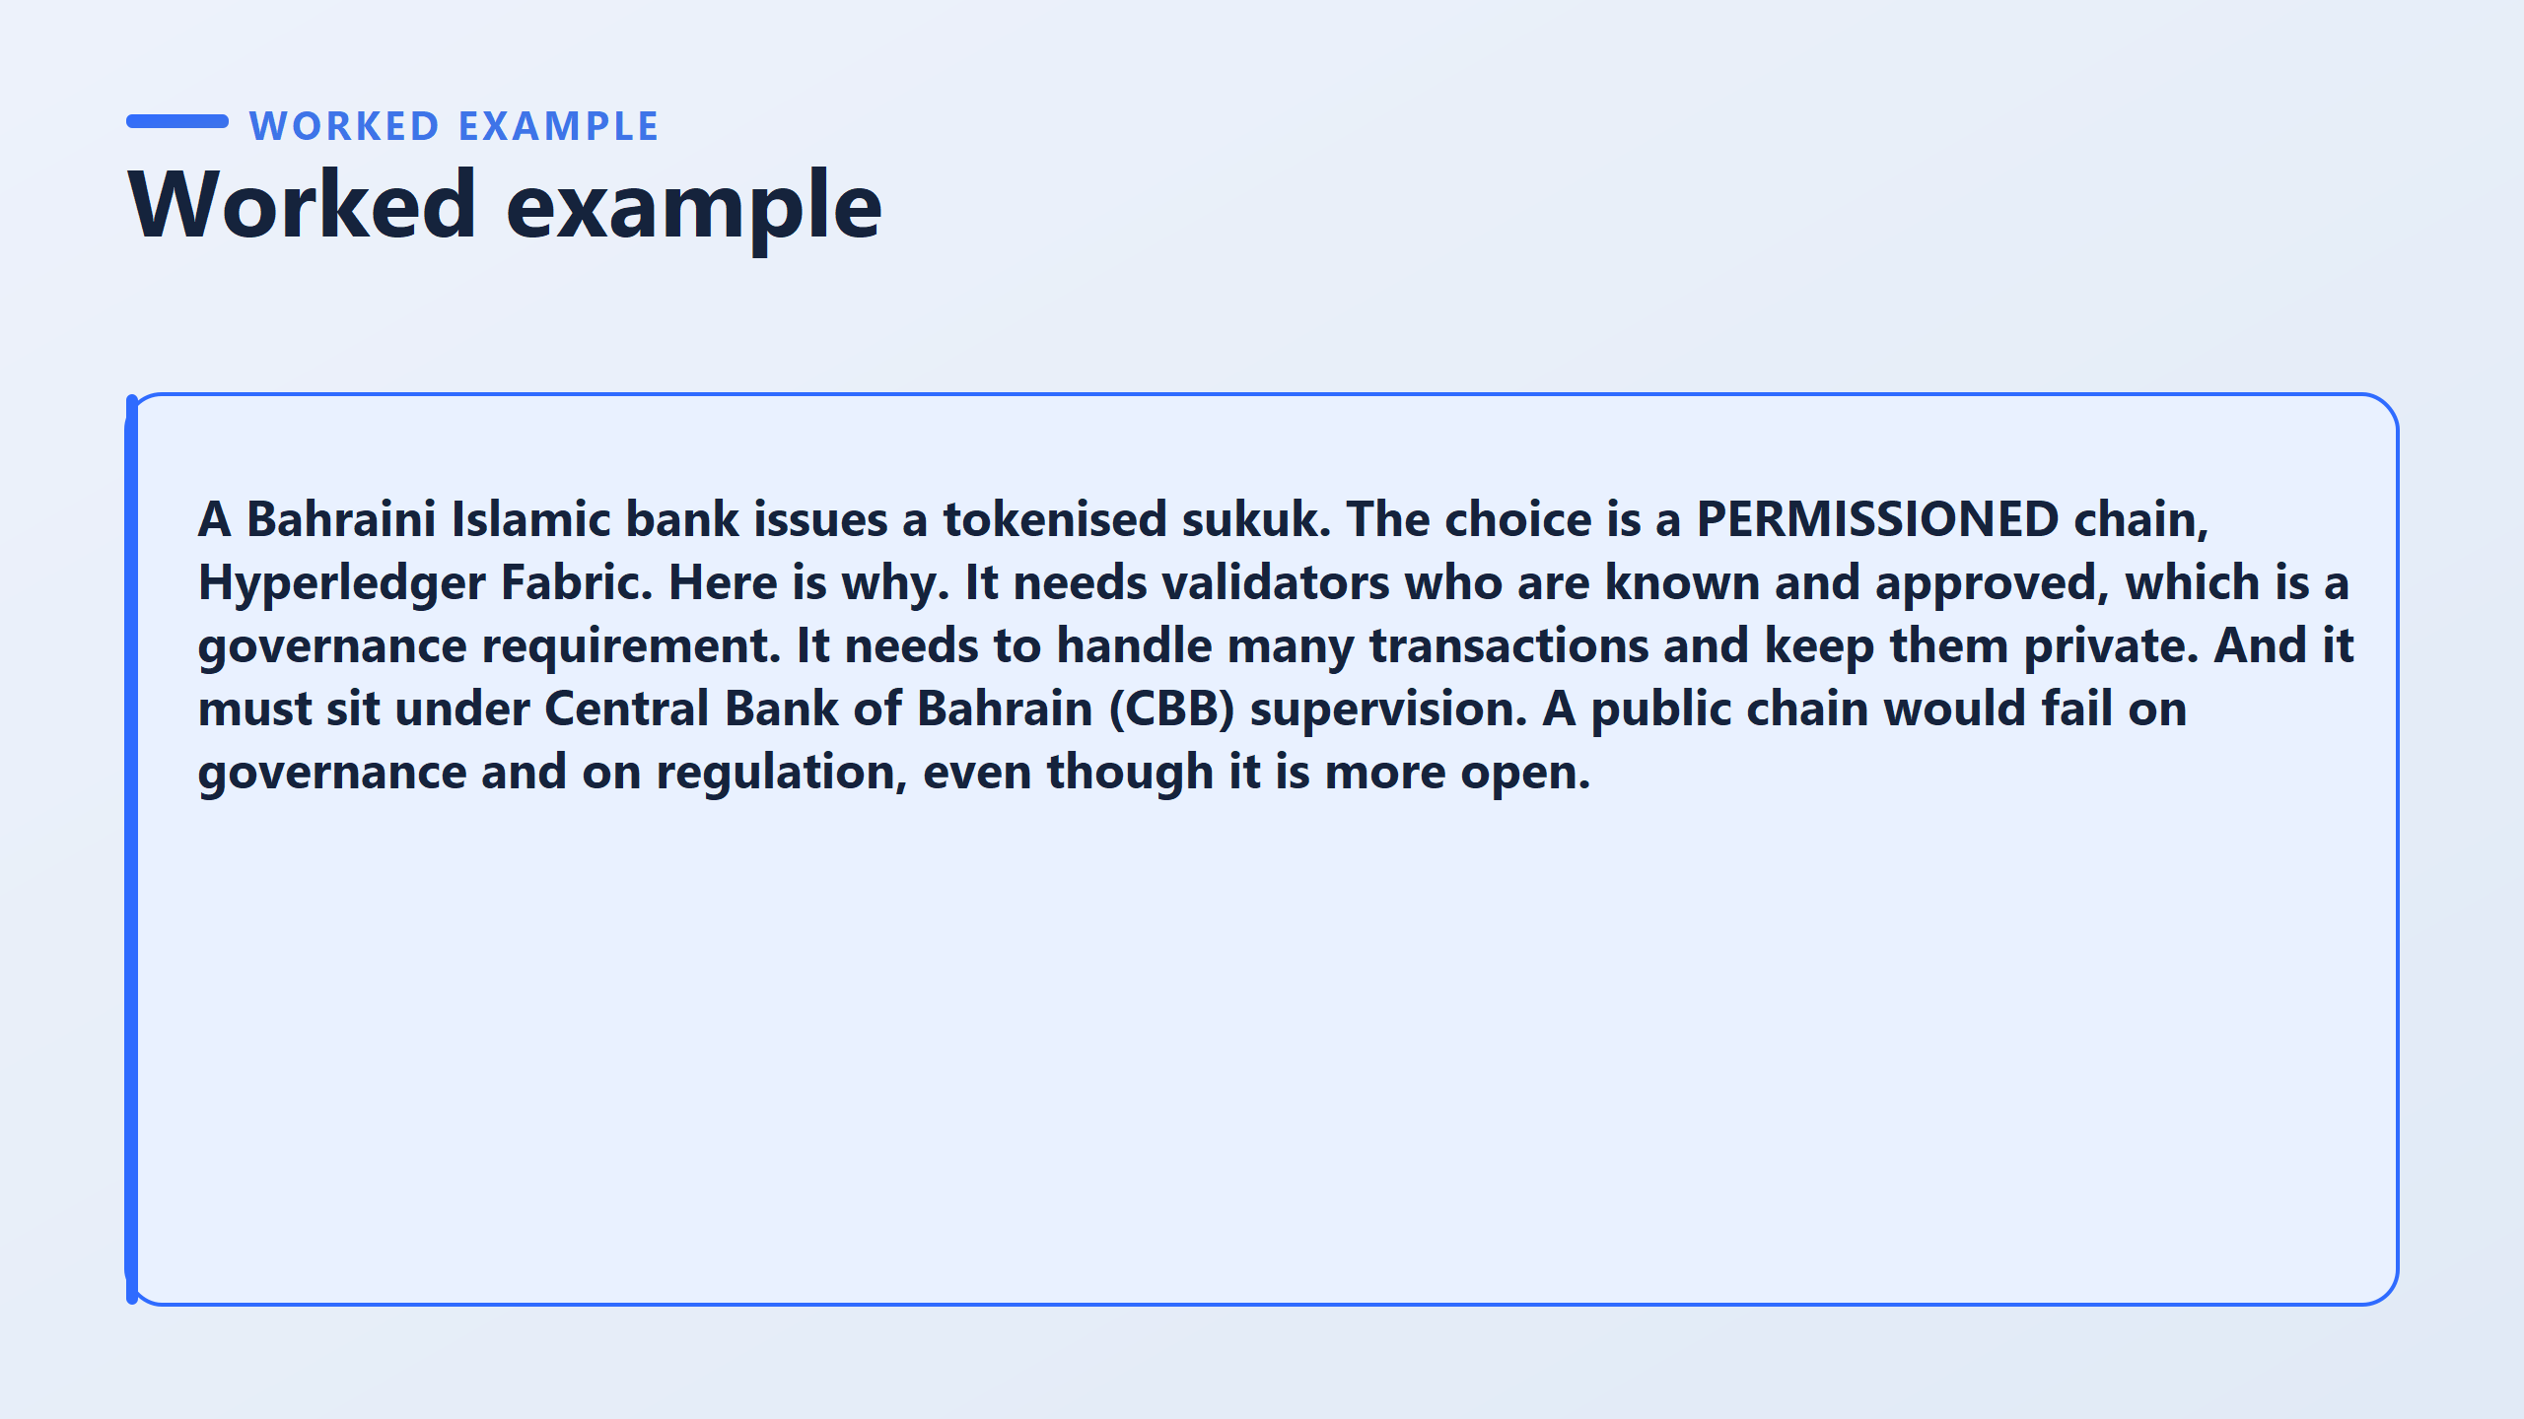
A sukuk is an Islamic finance instrument structured to comply with Sharia, giving investors a share in an underlying asset rather than interest on a loan.
Tokenising it means representing ownership of those shares as digital records on a ledger. Bahrain is a major Islamic finance centre, so this is a live commercial question here and not a hypothetical one.

Slide 16
Trust: the participants are a bank, its investors and its regulator, all identifiable. Nothing here requires a design that assumes strangers.
Throughput: a securities issue needs reliable, timely settlement, and the permissioned option is stronger on this.
Governance: the bank must be able to say who approves a change and who is accountable for it. On an open chain the honest answer is nobody in particular.
Regulation: the Central Bank of Bahrain supervises the issuer, and a supervisor needs a named entity to hold responsible.
Hint for the worksheet
Governance and regulation together settle the case, and they settle it before any technical comparison begins.
The open option is not rejected for being slow or immature. It is rejected because it cannot supply an accountable party, and regulated finance requires one.
The wrong idea: that permissioned always wins in banking.
the charity example. Same rubric, opposite answer.
The use case decides, and the mark is for naming which criterion did the deciding.

Slide 17
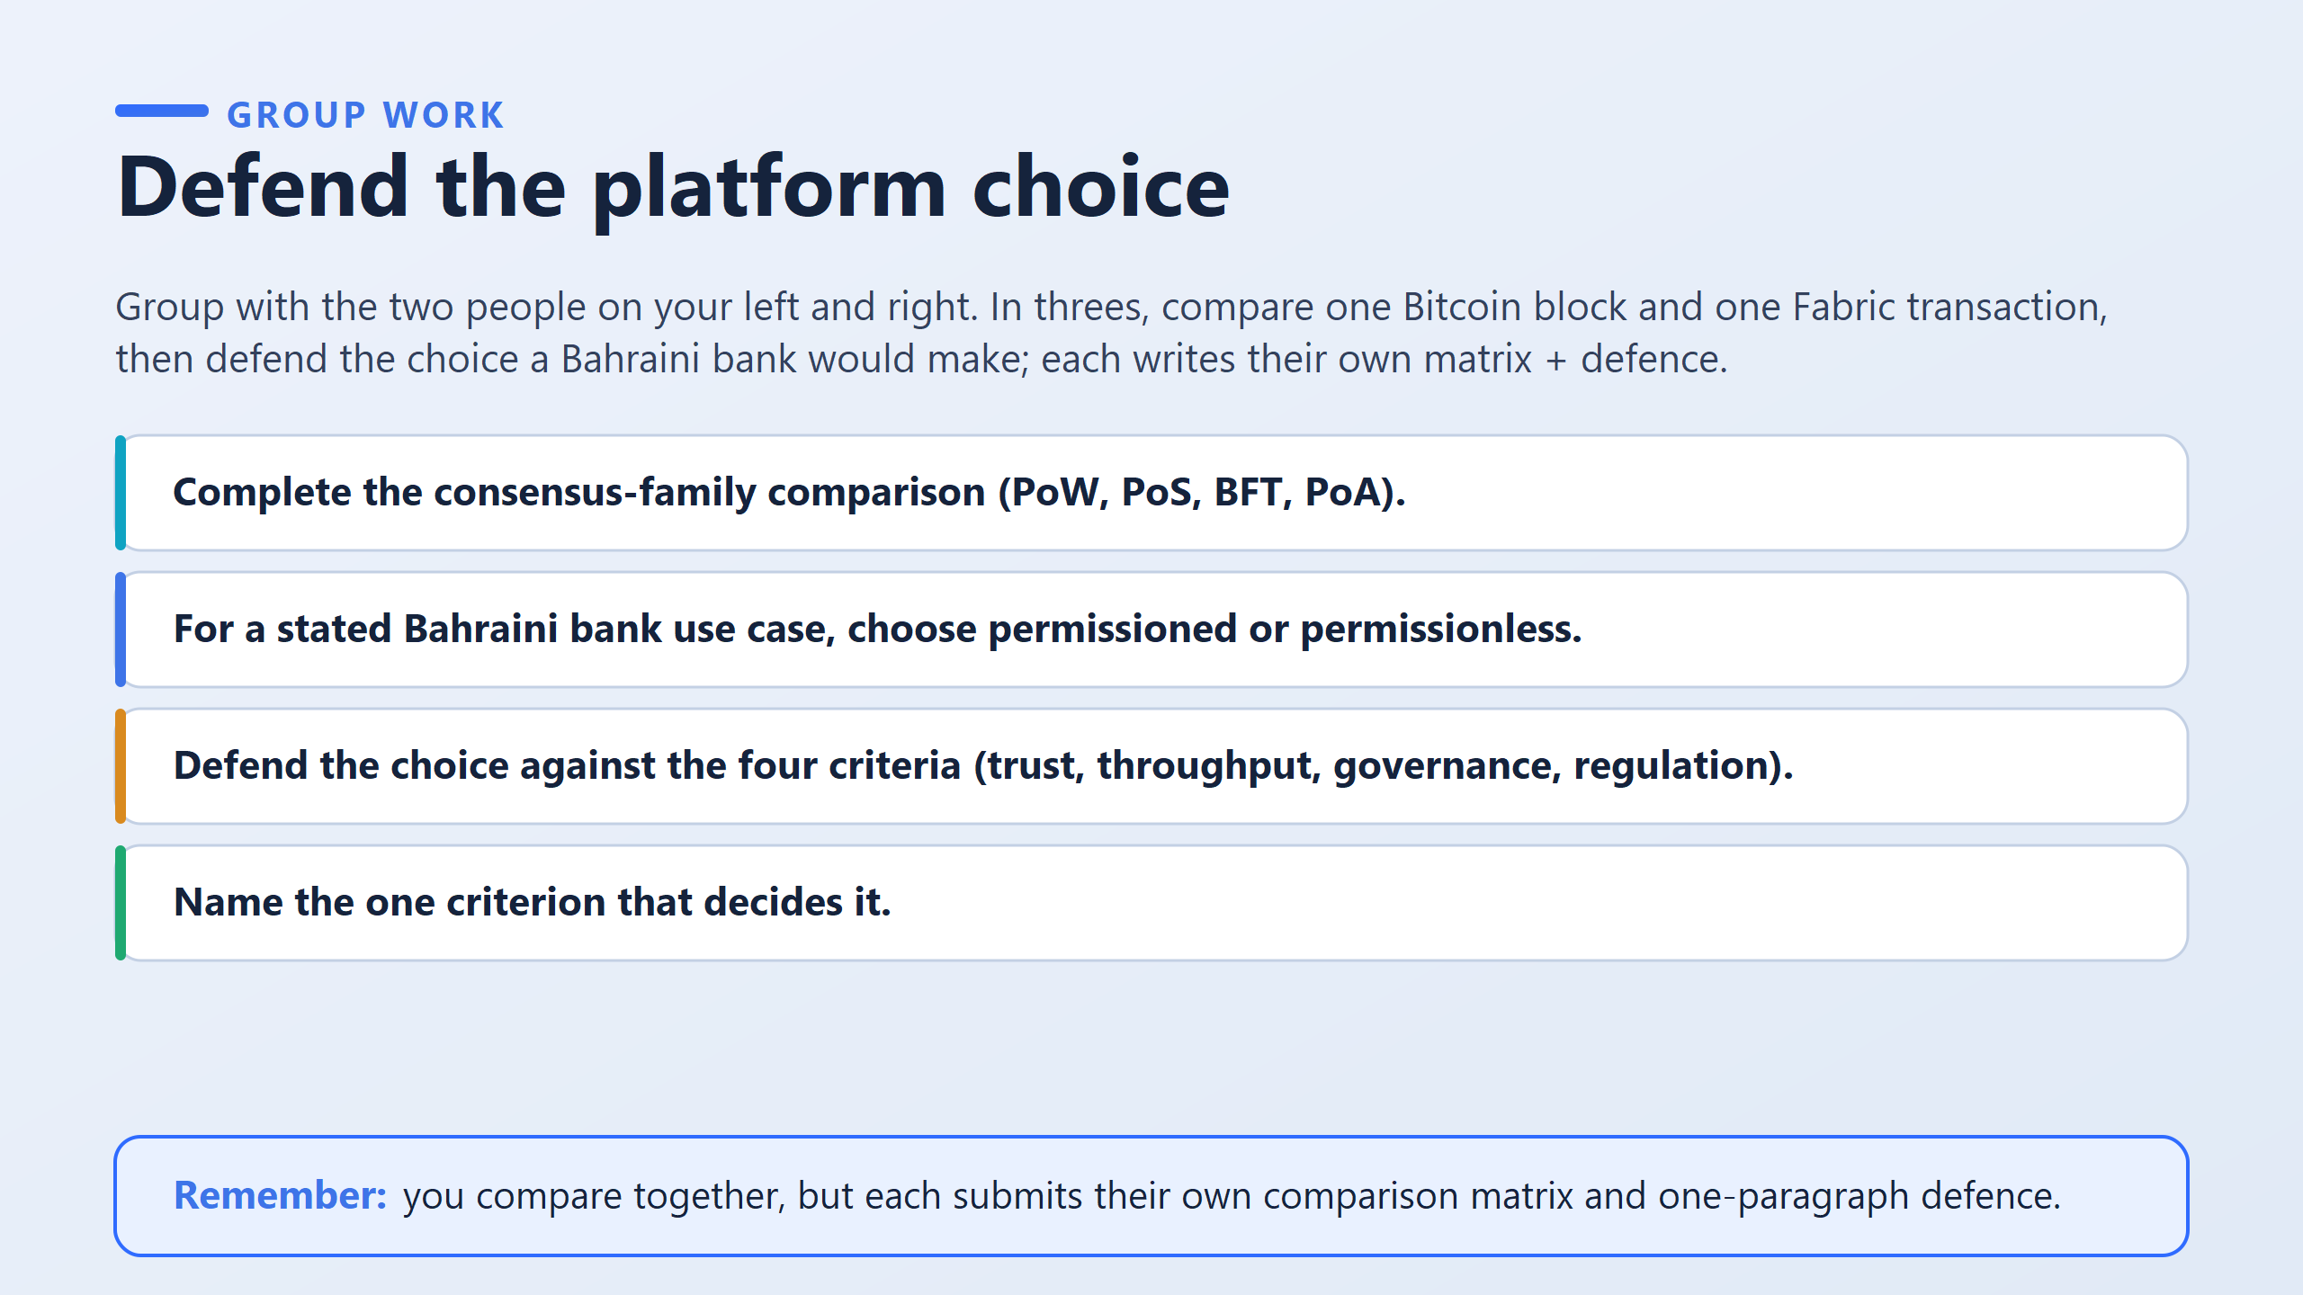

Slide 18
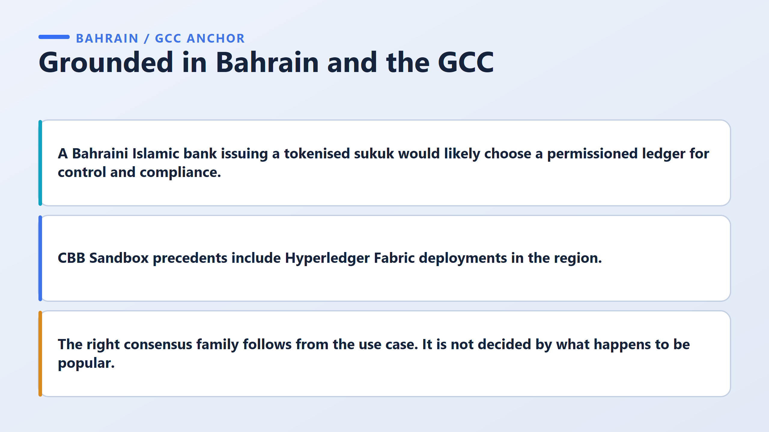
"Which blockchain is popular?"
Instead “we need to think”:
"What does my application require?“
For example:
Bitcoin-like public currency : Decentralization, open participation
Bank's internal network : Control, identity, compliance
Supply-chain consortium : Multiple known organizations
Public cryptocurrency : Open participation and censorship resistance
So different applications can require different consensus approaches.
The main lesson is that we don't choose a blockchain because it is popular.
We first understand the use case and its requirements, and then choose the appropriate ledger and consensus mechanism."

Slide 19
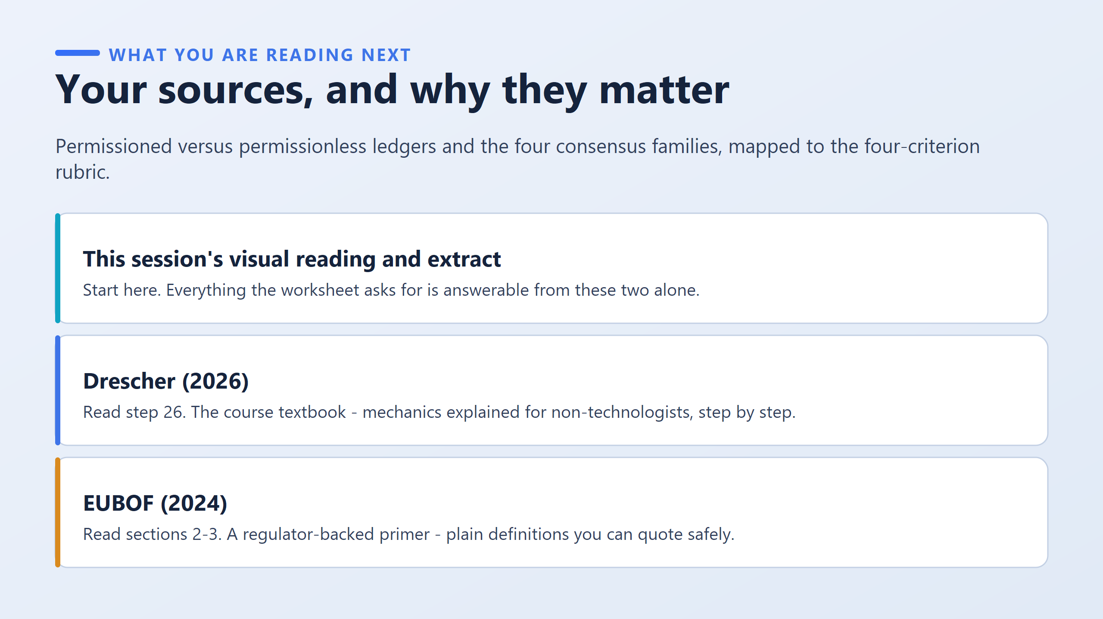

Slide 20
